Slide 1
Overview
1) Irradiance Comparison (Middle step)
1) Performance Comparison (end step)
Calculate Performance from Weather Measurements
Use various softwares: SAM, bifacialVF/br+Pvlib, and PVSyst
Explore different SR for albedometer and POA sensors, and different sensor locations effects
Compare at middle point with measured field POA and then with Performance data
2) Calculate Performance from POA measurements
Use various softwares: SAM, bifacialVF/br+Pvlib, and PVSyst
Explore using GFront only, or Gfront+Grear from various sensors including different SR, locations, he Reference Module, and the Rotating Albedometer approach
IMT Albedo
GHI
IMT Albedo
GHI
DHI + DNI
?
DHI + DNI
?
CM11 Albedo
CM11 Albedo
2) Performance comparison
Uncertainties Distribution?
Rotating Alb.
HYDRA
Front Only POA
Rotating Alb.
Measured Front and Rear POA
Reference Module
Measured Front and Rear POA
Hydra

Slide 2
Study suggestion:
1 year data from May 2021 to May 2022
Many system interruptions starting May 22 for measurements.
Only ~3.5 months of Rotating Albedometer (Method 3) data. Could use all the way to August
Select also sets of 3 days between Feb. 22 to May 22 to look closer at the comparison for ALL methods for ‘capacity testing’
Choose 1 set of nice clear sky days, and 1 set that has funky snow.
Notes:
Doing 3 days or doing 1 year is the same for most softwares; we run the full year and then single out into the chosen 3 day sets for plots or analysis.
More data: better bias reduction, but more RMSE.
Technically ~3 years of data available for 2 bifacial rows, and 1 monofacial string level comparison.
Nov. 2020 one extra bifacial row added (total of 3 bifacial rows open data available)
Spectrum Responsivity effects and ‘location’ of sensors effects can be evaluated and interpreted as ‘uncertainty’ for all the variations of methods.

Slide 3
Combinations of Measurements and Modeling Steps

Slide 4
Method 0a
DNI
DHI
Model Front Irradiance
Model Performance
Compare to Measured
Performance
GHI
Albedo Data (GHI + GRI)
Model Rear Irradiance

Slide 5
Method 0b
DNI
DHI
Model Front Irradiance
Model Performance
Compare to Measured
Performance
GHI
Albedo Data (GHI + GRI)
Model Rear Irradiance

Slide 6
Method 1a
DNI
DHI
Model Front Irradiance
Model Performance
Compare to Measured
Performance
GHI
Model Rear Irradiance
Albedo Data (GHI + GRI)

Slide 7
Method 1b
DNI
DHI
Model Front Irradiance
Model Performance
Compare to Measured
Performance
GHI
Model Rear Irradiance
Albedo Data (GHI + GRI)

Slide 8
Method 1c
Measure Front POA
DNI
DHI
Model Front Irradiance
Model Performance
Compare to Measured
Performance
GHI
Model Rear Irradiance
Albedo Data (GHI + GRI)

Slide 9
Method 2a
Measure Front POA
DNI
DHI
Model Front Irradiance
Model Performance
Compare to Measured
Performance
GHI
Model Rear Irradiance
Albedo Data (GHI + GRI)

Slide 10
Method 2b
Measure Front POA
DNI
DHI
Model Front Irradiance
Model Performance
Compare to Measured
Performance
GHI
Model Rear Irradiance
Albedo Data (GHI + GRI)
Measure Rear POA

Slide 11
Method 3?
Measure Front POA
DNI
DHI
Model Front Irradiance
Model Performance
Compare to Measured
Performance
GHI
Model Rear Irradiance
Albedo Data (GHI + GRI)
Measure Rear POA
Rotating Albedometer

Slide 12
Method 4a
Measure Front POA
DNI
DHI
Model Front Irradiance
Model Performance
Compare to Measured
Performance
GHI
Model Rear Irradiance
Albedo Data (GHI + GRI)
Measure Rear POA
Rotating Albedometer
Reference Module Rear Irradiance
Reference Module Front + Rear Irradiance (HYDRA)

Slide 13
Method 4b
Measure Front POA
DNI
DHI
Model Front Irradiance
Model Performance
Compare to Measured
Performance
GHI
Model Rear Irradiance
Albedo Data (GHI + GRI)
Measure Rear POA
Rotating Albedometer
Reference Module Rear Irradiance
Reference Module Front + Rear Irradiance (HYDRA)

Slide 14
REAL ASTM
MEASURED DATA
Getting Regression coefficients
Reporting Conditions
Getting Regression
Coefficients
SAM MODEL OUTPUTS:
MEASURED DATA
TMY
Method 1
Regression
POA front
Regression
Method 1
POA front
Method 2
POA
rear
Method 2
Result Expected
Result Measured
POA
rear
Performance
Reporting Conditions
METHOD ONE FOR IEC
DNI
DHI
Method 1
POA front
Correct Performance
F(POA, Tmod)
Method 1
Mod Temp
Performance
Tamb
Method 2
Performance
POA
rear
Alb
POA front
Tmod
Notes:
Method 1 Assumes albedo is same when you generate regression for expected and regression for measured conditions
Method 1 considers albedo is same when you generate regression for expected and regression for measured conditions by filtering for albedo inputs
Model output for POA rear – that is part of the regression. When you have

Slide 15
METHOD TWO FOR ASTM
MEASURED DATA
Getting Regression coefficients
Reporting Conditions
Getting Regression
Coefficients
SAM MODEL OUTPUTS:
MEASURED DATA
DNI
DHI
Method 1
Regression
POA front
Regression
Method 1
POA front
Method 2
POA
rear
Method 2
GHI
Result Expected
Result Measured
POA
rear
Performance
Albedo Data (GHI + GRI)
Reporting Conditions
METHOD TWO FOR IEC
POA front + rear
Method 2
Correct Performance
Performance
Performance
Tmod
Tmod
Notes:
Method 1 Assumes albedo is same when you generate regression for expected and regression for measured conditions
Method 1 considers albedo is same when you generate regression for expected and regression for measured conditions by filtering for albedo inputs
Model output for POA rear – that is part of the regression. When you have

Slide 16
METHOD ONE FOR ASTM
MEASURED DATA
Getting Regression coefficients
Reporting Conditions
Getting Regression
Coefficients
SAM MODEL OUTPUTS:
MEASURED DATA
DNI
DHI
Method 1
Regression
POA front
Regression
Method 1
POA front
Method 2
POA
rear
Method 2
GHI
Result Expected
Result Measured
POA
rear
Performance
Albedo Data (GHI + GRI)
Reporting Conditions
METHOD ONE FOR IEC MAYBE PVSYST??
POA front
Method 1
POA front
Correct Performance
F(POA, Tmod)
Method 1
POA front
Mod Temp
Performance
Method 2
Performance
POA
rear
POA Grear
POA Grear
Notes:
Method 1 Assumes albedo is same when you generate regression for expected and regression for measured conditions
Method 1 considers albedo is same when you generate regression for expected and regression for measured conditions by filtering for albedo inputs
Model output for POA rear – that is part of the regression. When you have

Slide 17
Go back to bar chart,
Biggest variation from sam 00 ~ → run that

Slide 18
METHOD TWO FOR ASTM
Getting Regression coefficients
Reporting Conditions
MEASURED DATA
Getting Regression
Coefficients
SAM MODEL OUTPUTS:
MEASURED DATA
DNI
DHI
Method 1
Regression
POA front
Regression
Method 4
HYDRA
Method ‘2’
POA
rear
GHI
Performance
Albedo Data (GHI + GRI)
Reporting Conditions
METHOD TWO FOR IEC
HYDRA
Method ‘2’
Regression
Regression
Method 1
HYDRA
Performance

Slide 19
Predicted vs expected last week
Expected vs measured
ASTM regression….
Regression on model side, regression on measured side, select equivalent reporting conditions and do comparison. Comparison every week.

Slide 20
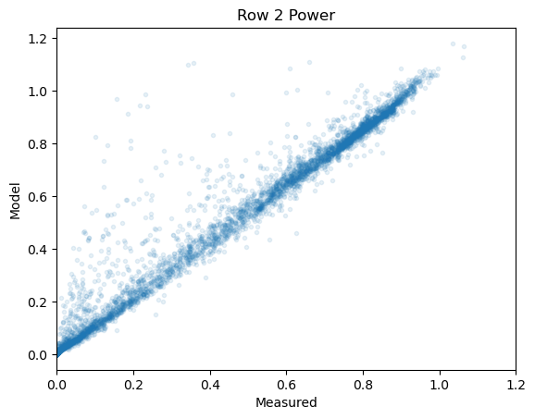

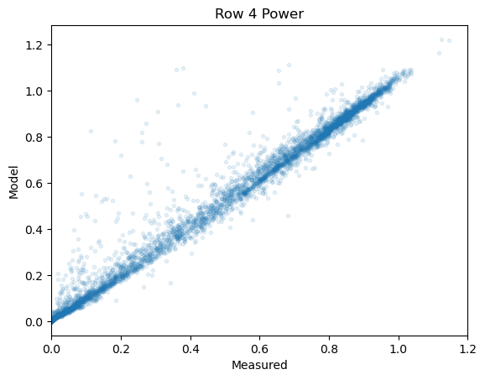
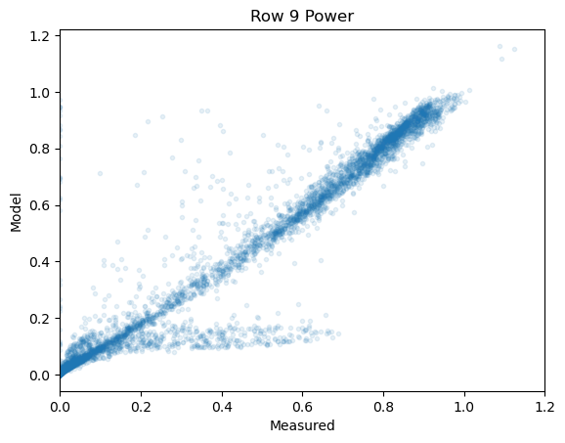
SIM 00

Slide 21
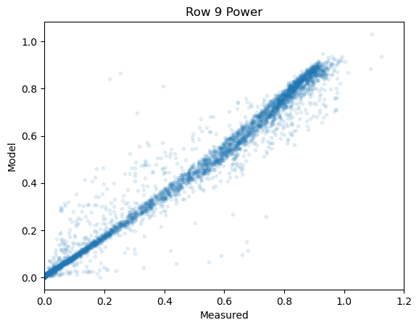
Modeling from measured
DNI and DHI
Modeling from measured POA

Slide 22
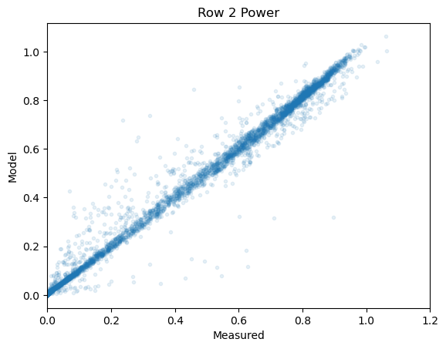
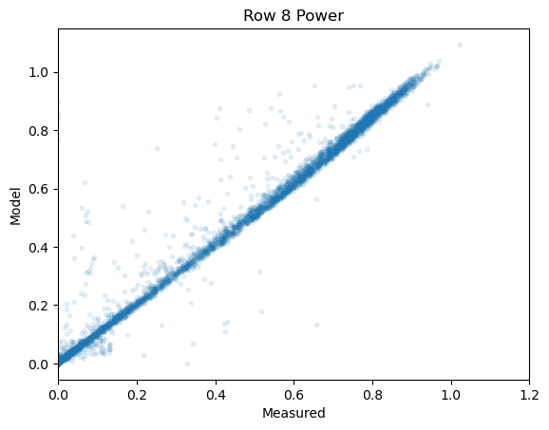
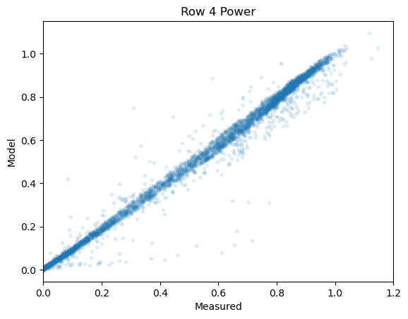
SIM P00

